Slide 1
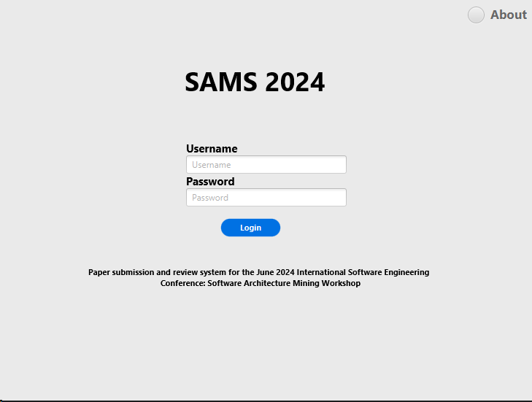
Prepared by Group 2 Londhe, Soudagar, srl1622 Sajjala, Swetha, ss5743 Skalicky, Stacy, sms7705 Vellaisamy Senthilkumar, Rohini, rv8542

Slide 2
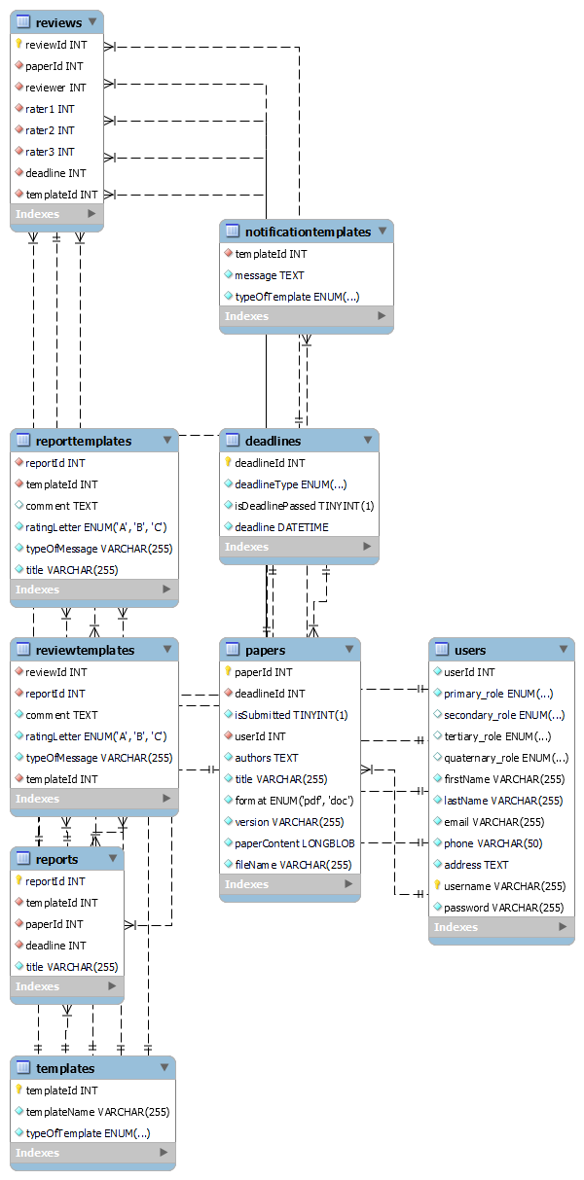
Domain Entity Diagram

Slide 3
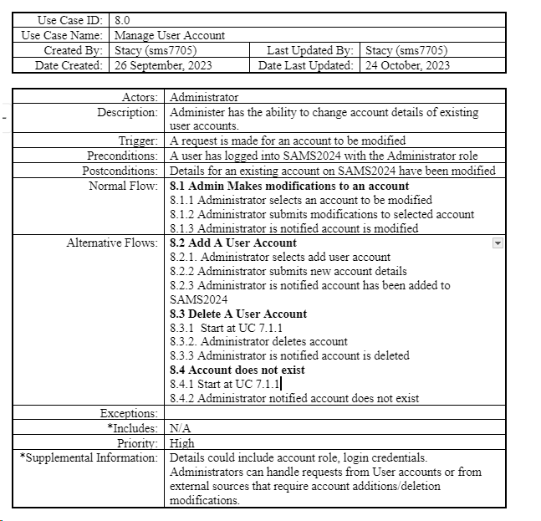

Slide 4
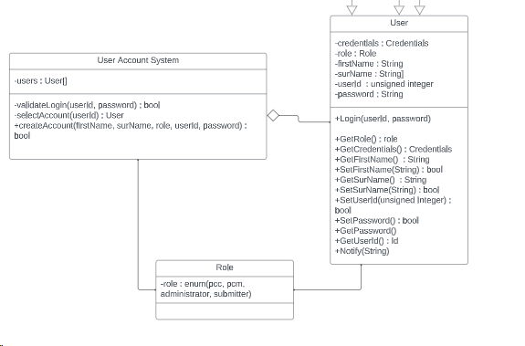
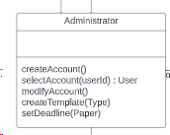
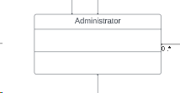
Evolution of a Class
Class Diagram
Domain diagram
Detailed Design (Final)
See next slide!

Slide 5
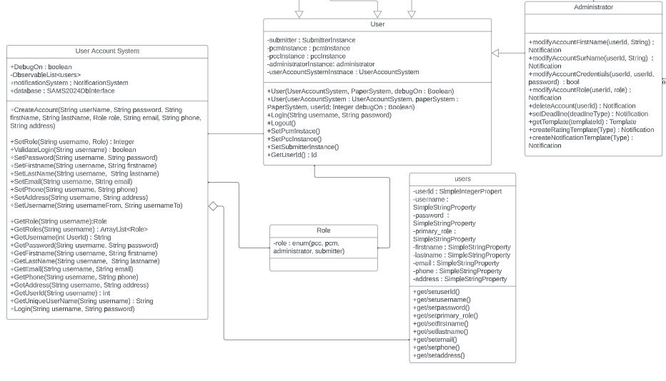
Detailed Design Final

Slide 6
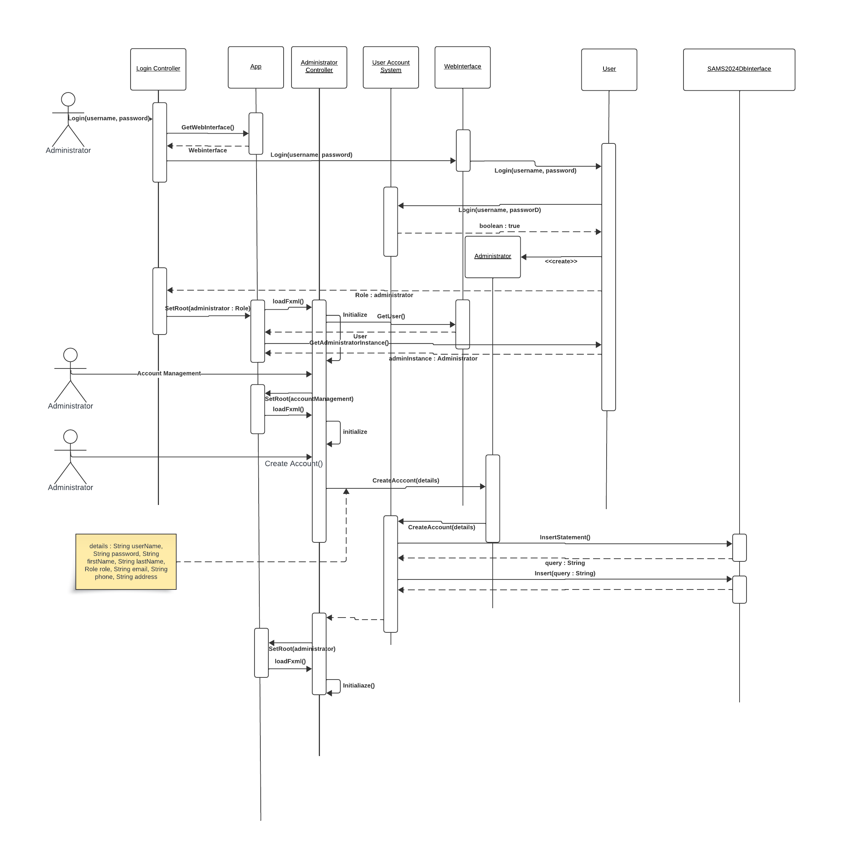
Sequence of Main Flow

Slide 7
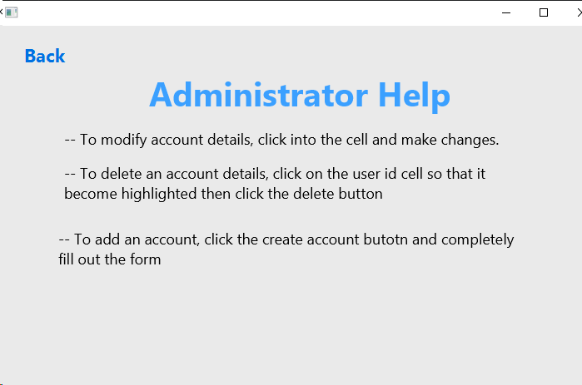
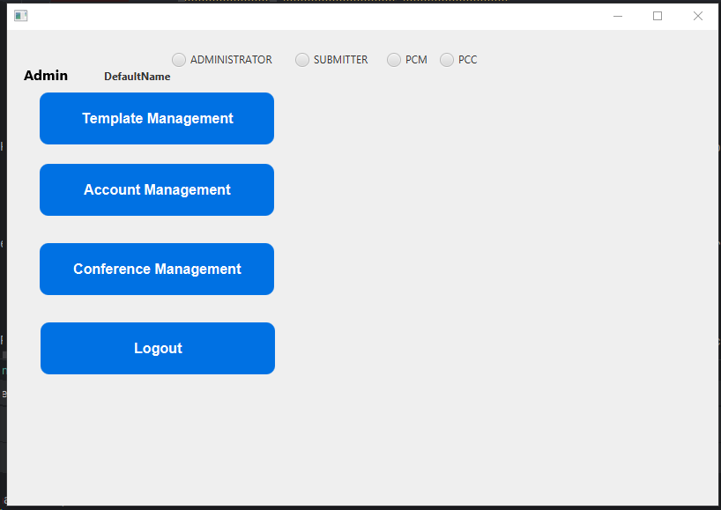
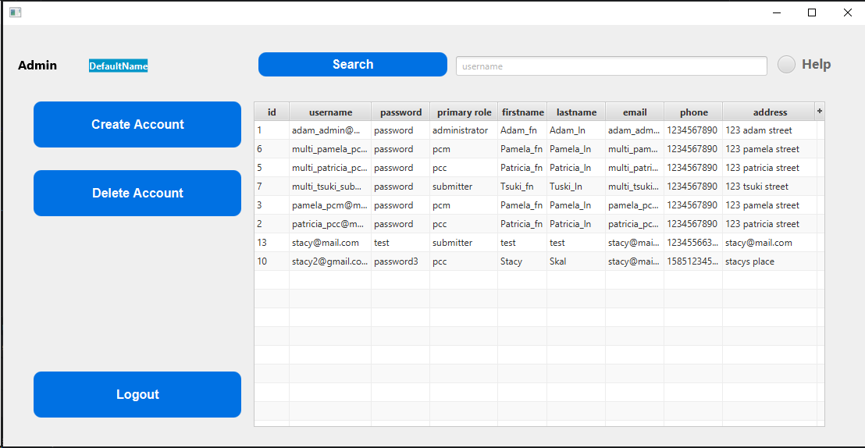

Slide 8
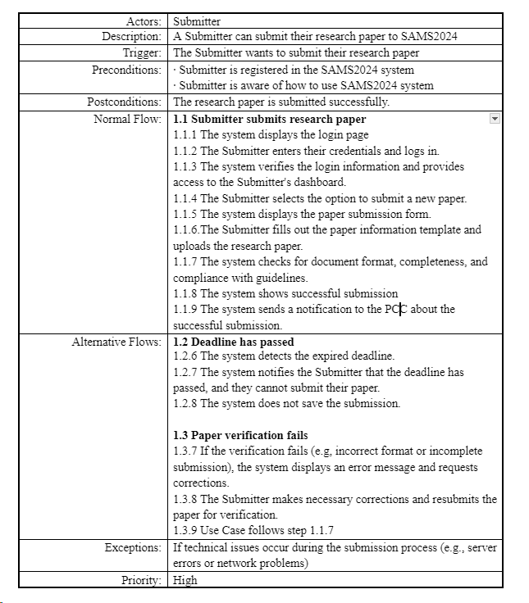

Slide 9
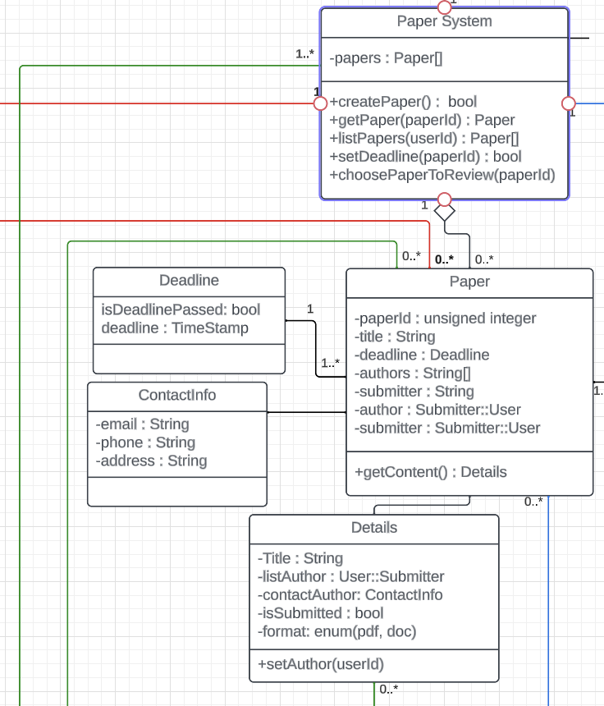
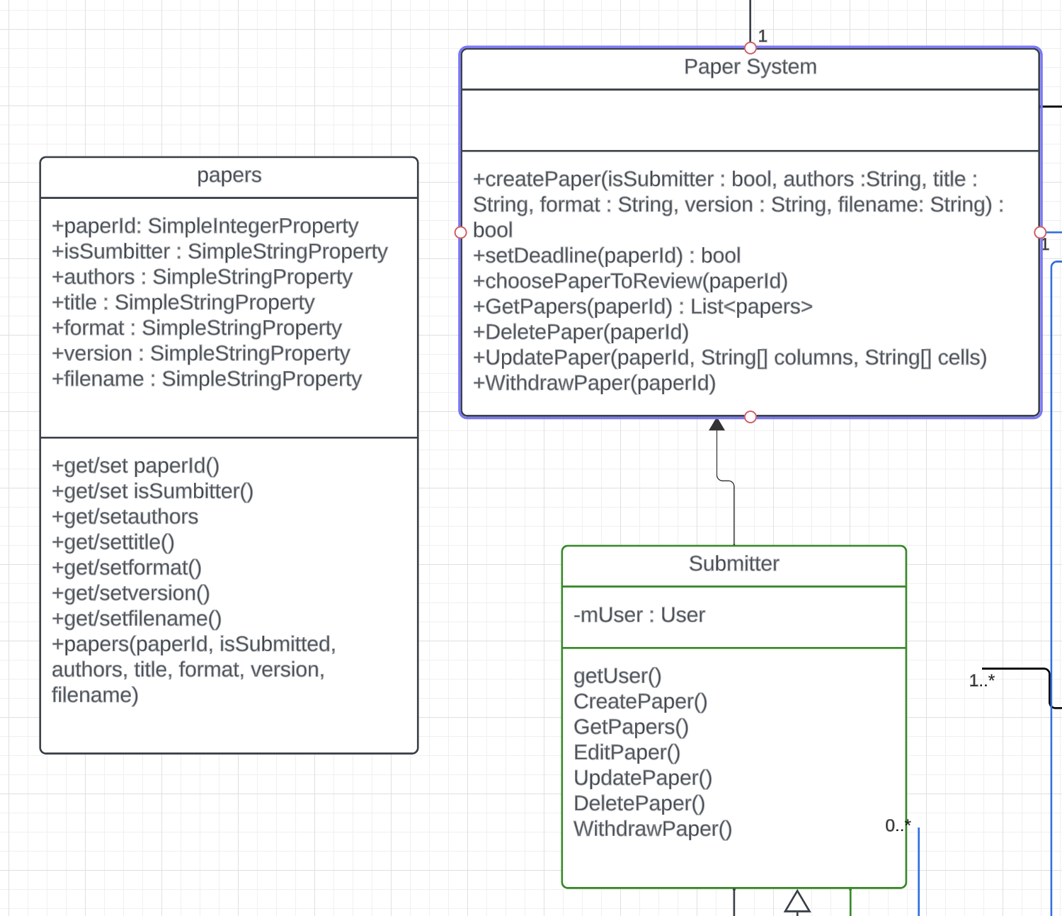
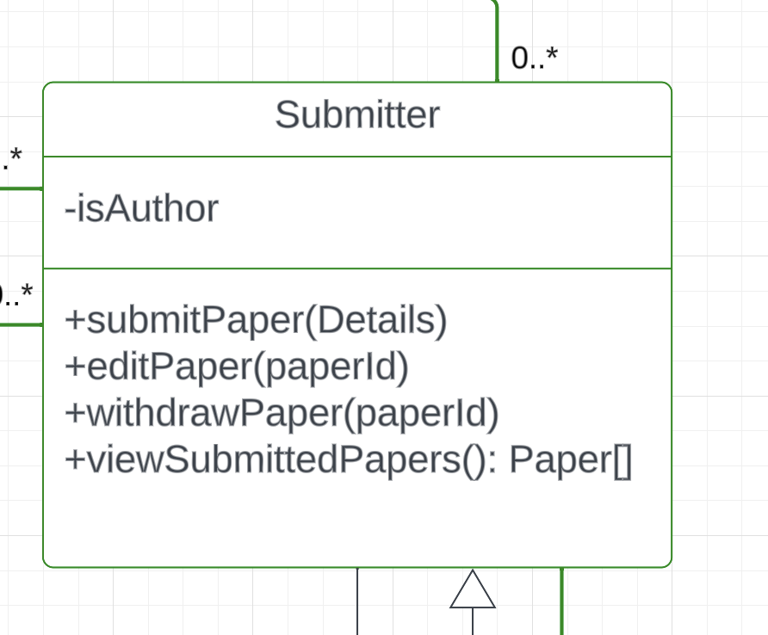
Evolution of a Class
Class Diagram
Detailed Design
Domain diagram

Slide 10
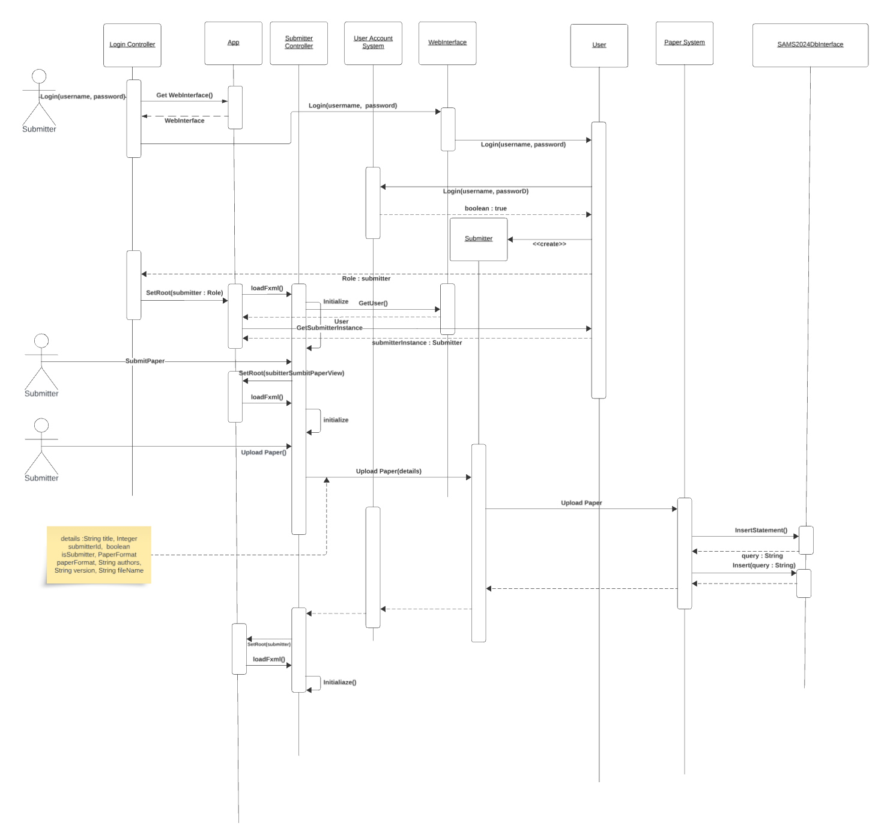
Sequence of Normal Flow : Submitter submitting a paper

Slide 11
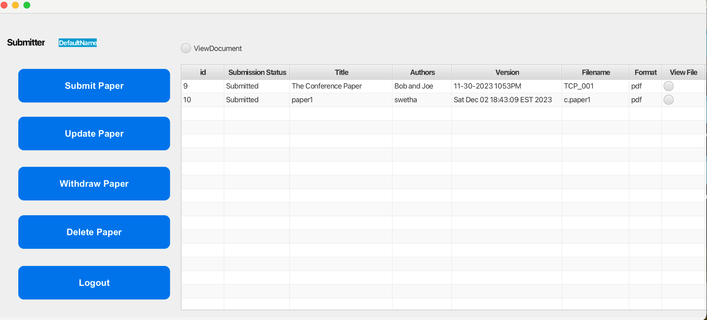
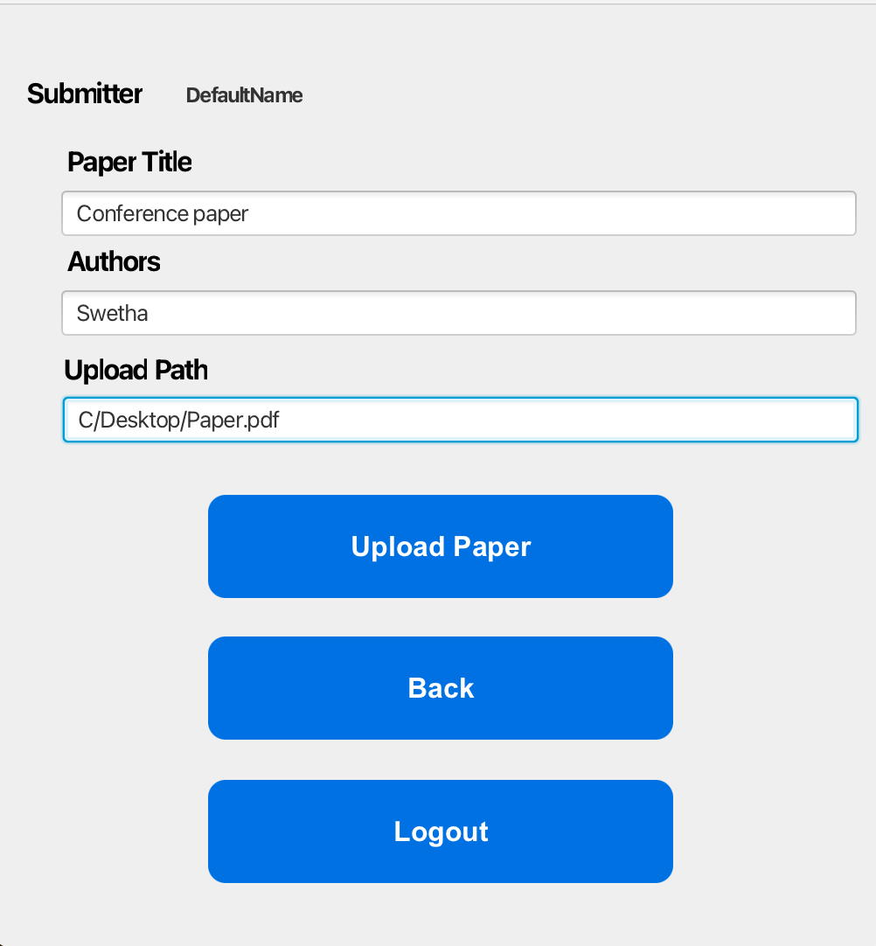
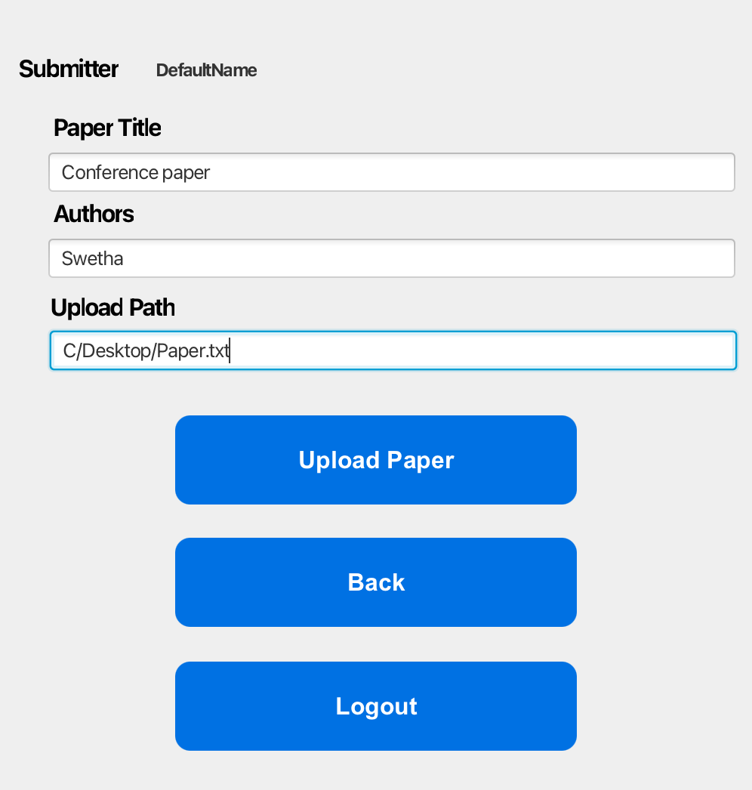
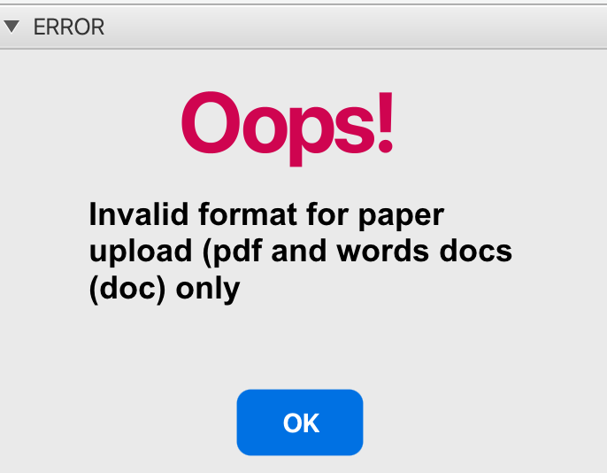

Slide 12
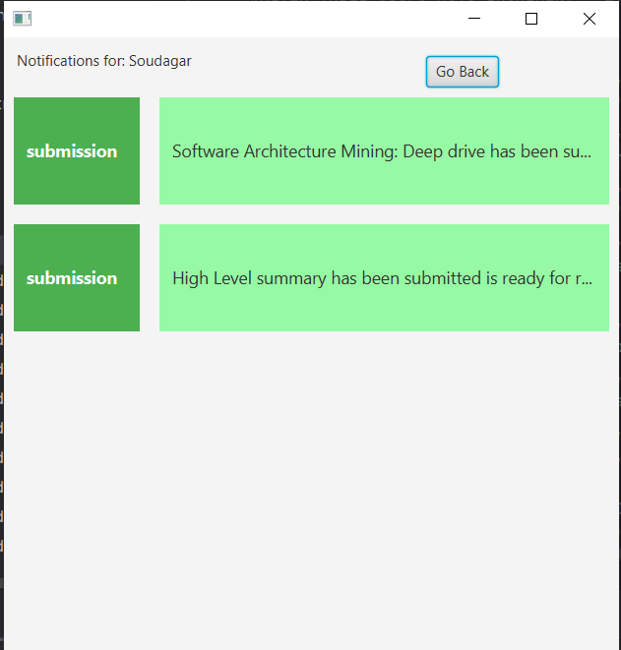
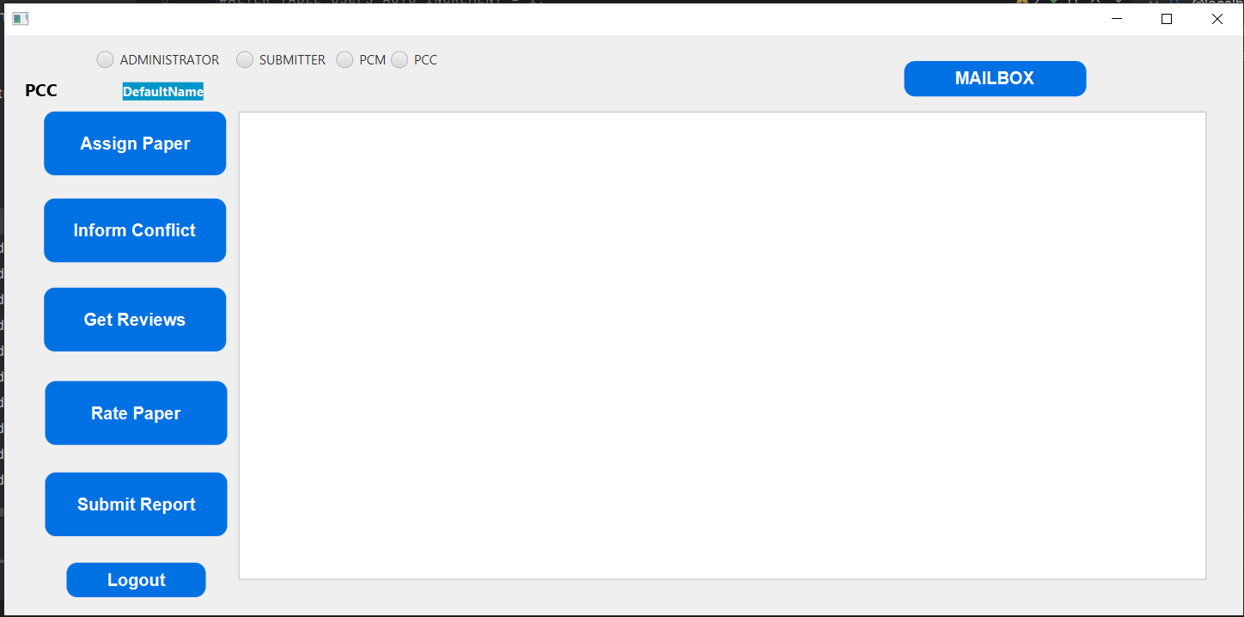

Slide 13
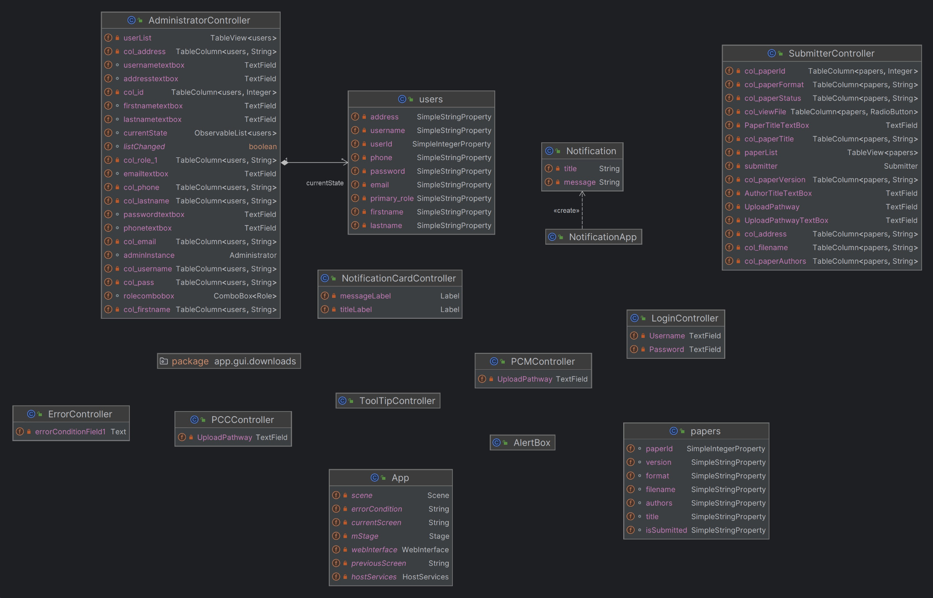
Front End

Slide 14
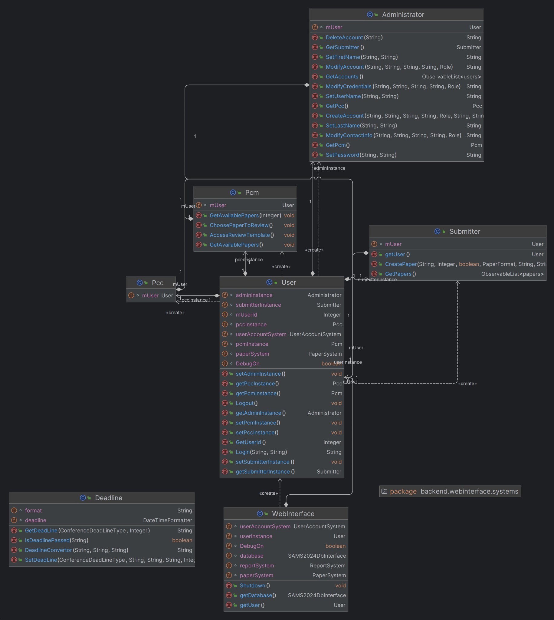
Web Interface
← Next slide

Slide 15
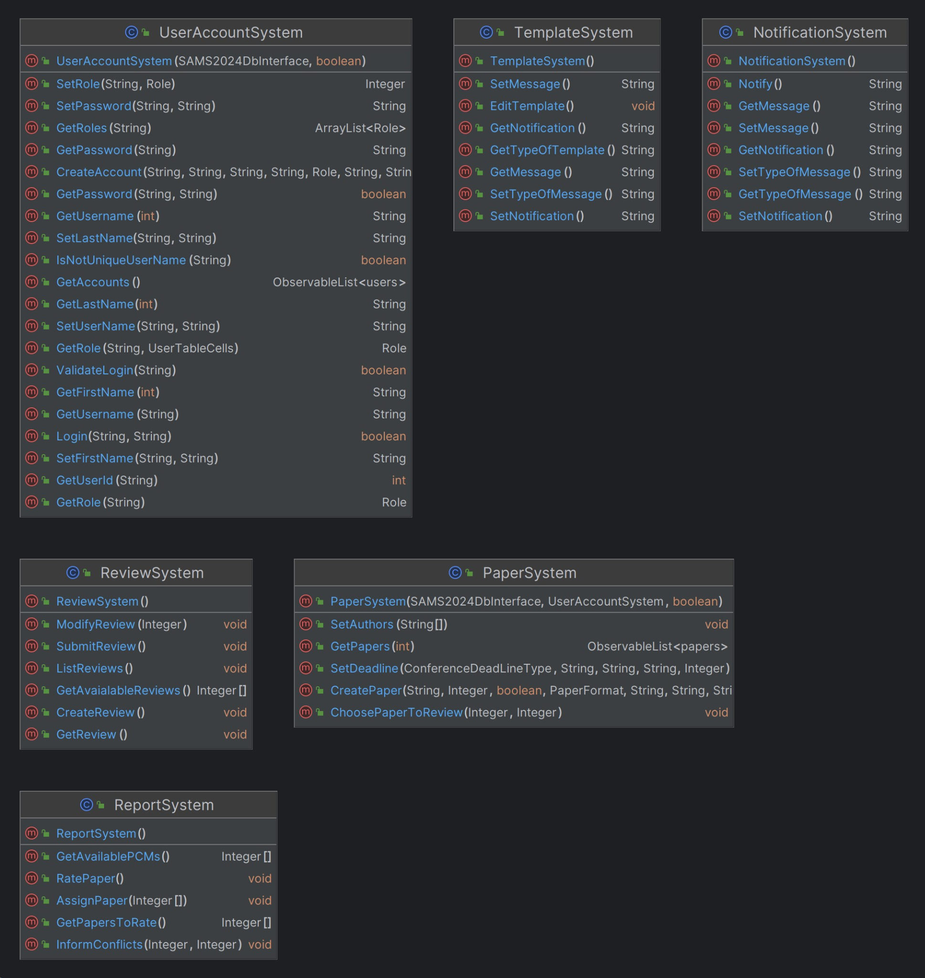
Systems

Slide 16
Challenges during implementation
Database Implementation: Execute the database plan outlined.
Transition from React to JavaFX: Swift adaptation from React to JavaFX framework.
Design De-obfuscation and Translation to Implementation: Clarify and translate design elements to facilitate seamless implementation within the team.
Timeline Decisions for Scope Limitation: Strategic decisions on the timeline to restrict and manage project scope.
Unit Testing: Implementation and execution of unit tests for quality assurance.

Slide 17
Limitations and Improvements
MySQL and Blob Enhancements for PDF Upload/Download: Enhancements focused on improving PDF upload and download functionality using MySQL and Blob.
Elevated Emphasis on Unit Testing: Augmented efforts in unit testing for enhanced code quality and reliability.
Code Comments Enhancement: Increase the use of comments for better code understanding.
Optimized Task Tracking: Utilize Trello/Jira more effectively for improved task management.

Slide 18
Questions??

Slide 19


